Slide 1
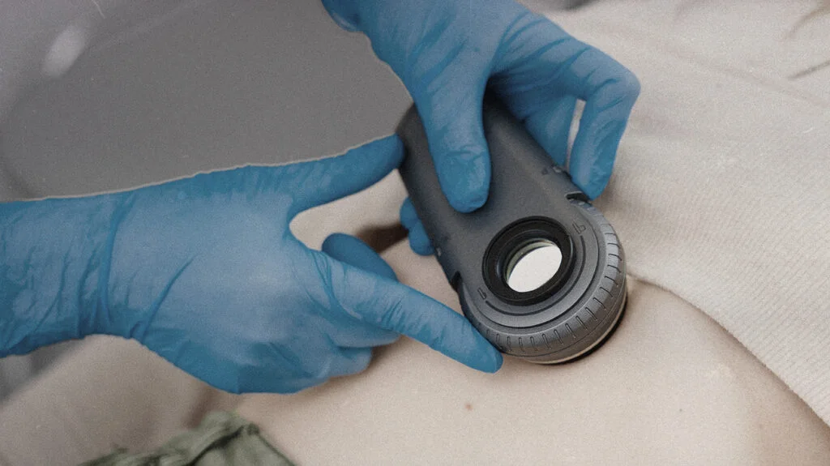
Multi-Class Skin Lesion Classification
Benchmarking Classical Estimators Against Deep Convolutional Architectures
Edward Nguyen
Erick Saldana
Bryan Ybarra

Slide 2
Background and Motivation
Prior Work
- Esteva et al. (Nature 2017): Demonstrated CNN performance matching board-certified dermatologists using deep transfer learning.
- Tschandl et al. (Scientific Data 2018): Introduced the HAM10000 dataset, establishing InceptionV3 benchmarks and highlighting class imbalance issues.
- International Skin Imaging Collaboration (ISIC) Benchmark Challenges: Advanced automated triage standards and multi-class lesion classification.
Clinical Challenge
Skin cancers account for significant global mortality, but early detection provides high cure rates. Visual screening shows high diagnostic variability across clinicians.
Our Focus
Developing and evaluating an automated multi-class skin lesion screening pipeline to reduce diagnostic variability in skin cancer detection, specifically investigating how deep transfer architectures compare to classical feature baselines in detecting lethal malignant lesions under severe clinical class imbalance.

Slide 3
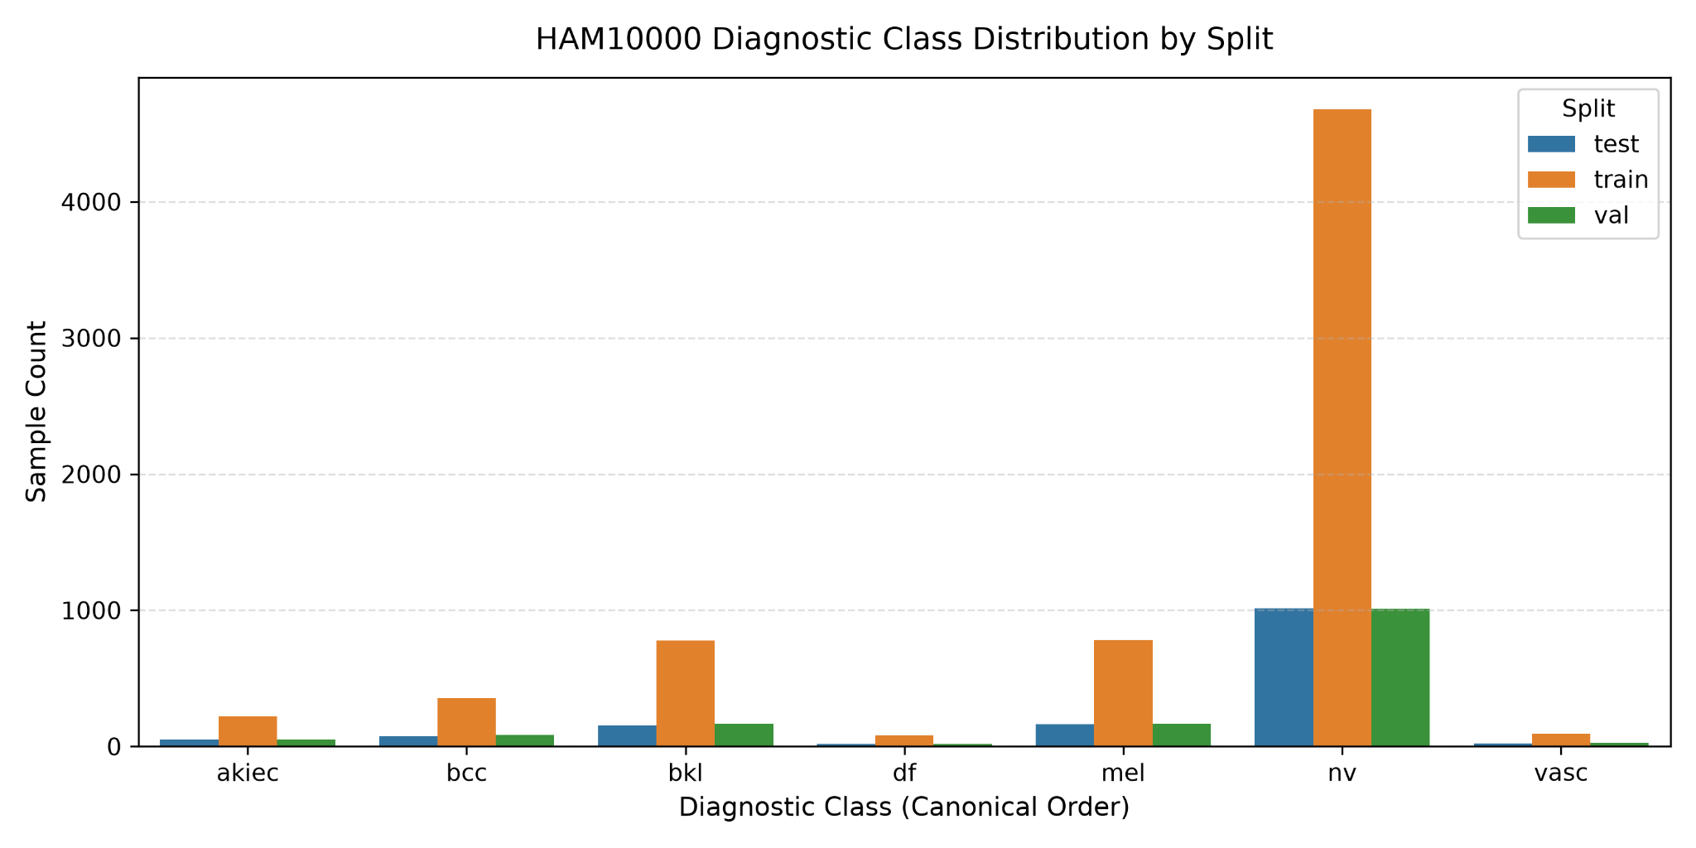
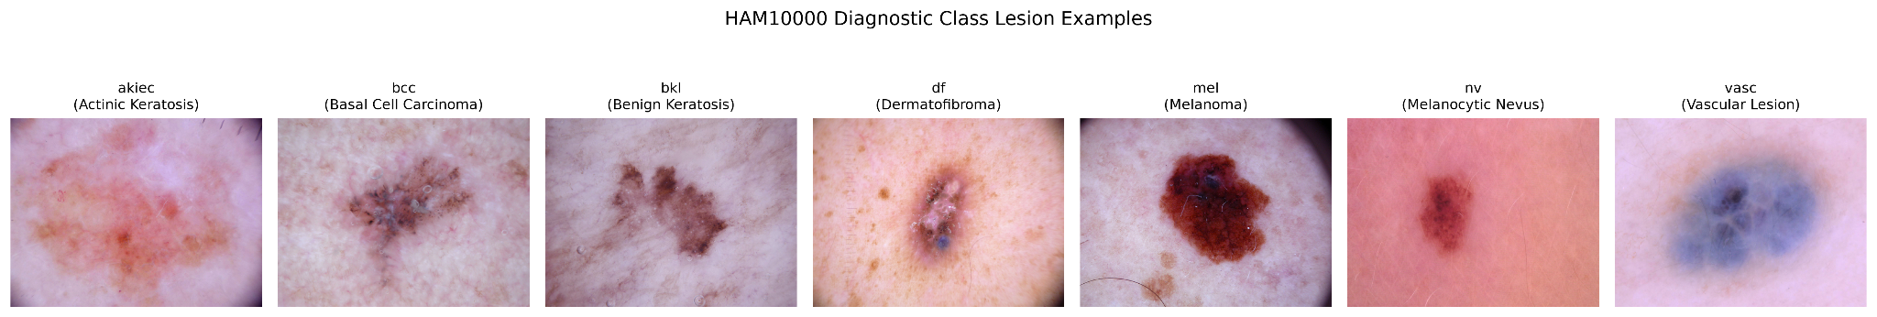
Dataset Anatomy and Partitioning Integrity
HAM10000 Dataset
Dataset Composition: 10,015 dermatoscopic images (600x450 RGB) corresponding to 7,470 unique lesions.
Seven Diagnostic Categories:
Actinic keratoses (akiec)
Basal cell carcinoma (bcc)
Benign keratosis (bkl)
Dermatofibroma (df)
Melanoma (mel)
Melanocytic nevi (nv)
Vascular lesions (vasc)
Class Imbalance: 58 to 1 ratio (melanocytic nevi at 6,705 samples vs dermatofibroma at 115 samples). Naive majority-class prediction yields 67 percent accuracy.
Patient Leakage Elimination: Multi-view lesion images are partitioned strictly by lesion type (lesion_id) into frozen 70/15/15 train, validation, and test splits.

Slide 4
Preprocessing
Classical Feature Pipeline
Images downsampled to 64x64 grayscale. A 64-component PCA transformer fitted strictly on the training partition reduces dimensionality from 150,528 to 64 components and caches compressed matrices to disk.
Deep Learning DataLoader
PyTorch streaming pipeline loading 224x224 RGB tensors normalized via ImageNet parameters, applying train-only affine scaling, flips, and rotations while preserving clinical artifacts (hairs, bubbles, vignetting).
Geometric Resize Strategy Benchmark
Evaluated 3 resizing approaches on a fixed Random Forest baseline:
- Direct Resize: stretching 600x450 to 224x224
- Letterbox Padding: aspect-ratio preservation with black borders
- Center Cropping: 450x450 center square cropped
Resize Strategy | Balanced Accuracy | Accuracy
Direct Resize (Selected) | 0.2740 | 0.6614
Center Crop | 0.2704 | 0.6496
Letterbox Padding | 0.2519 | 0.6418
Direct resizing preserved lesion margins and achieved highest balanced accuracy without introducing artificial padding artifacts or risking peripheral border clipping.

Slide 5
Slide 5: Classical Estimator Methodology and Pipeline Architecture (Module B)
4 estimator paradigms (LR, KNN, SVM, RF)
Pipeline design, StandardScaler, and class weighting

Slide 6
Slide 6: Hyperparameter Optimization and Test Evaluation (Module B)
5-fold Stratified K-Fold grid search parameter spaces
Optimization outcomes, best configurations, and runtimes

Slide 7
Slide 7: Classical Model Error Analysis and Confusion Matrix Heatmaps (Module B)
Confusion matrix heatmaps (SVM vs Random Forest)
Diagnostic failure modes and PCA feature limitations

Slide 8
Slide 8: Deep Learning Architectures and Training Protocol (Module C)
Custom CNN architecture
EfficientNetB0 transfer learning and class-weighted loss

Slide 9
Slide 9: Neural Network Training Dynamics and Convergence (Module C)
Training and validation loss and accuracy curves
Convergence analysis and ImageNet feature prior benefits

Slide 10
Slide 10: Unified Benchmark: Classical Baselines vs Deep Neural Networks
Full-width 8-column comparative benchmark table

Slide 11
Slide 11: Deep Model Error Analysis and Diagnostic Confusion Matrices (Module C)
EfficientNetB0 confusion matrix heatmap
Malignant recall evaluation and bkl vs mel error analysis

Slide 12
Slide 12: Future Work: Research Replication and Model Advancement
Replication protocols
Methodological advances (Transformers, multimodal fusion)

Slide 13
Slide 13: Project Summary and Team Contributions
Key benchmark conclusions and performance takeaways

